Slide 1


Group Name : A
Team Member : Sartaj Ahmed Malik (BSCS-VII)
Team Member : Irfan Ali Narejo (BSCS-V)

Slide 2


Heart Disease Prediction

Slide 3
Libraries
Pandas
Numpy
Matplotlib
Seaborn
AdaBoostClassifier
sklearn.ensemble
ConfusionMatrixDisplay
train_test_split

Slide 4
GUI-Libraries
tkinter
Tkinter is a popular choice for building graphical user interfaces (GUIs) in Python.
preprocessing import StandardScaler
StandardScaler from the preprocessing module in scikit-learn scales features to have a mean of 0 and a variance of 1, aiding algorithms sensitive to feature scaling.
sklearn.ensemble
sklearn.ensemble offers ensemble learning methods (e.g., Random Forest, Gradient Boosting)
combining multiple models for improved predictions and robustness. sklearn.preprocessing
klearn.preprocessing normalizes, scales, encodes data for ML models, enhancing performance by prepping input features.

Slide 5
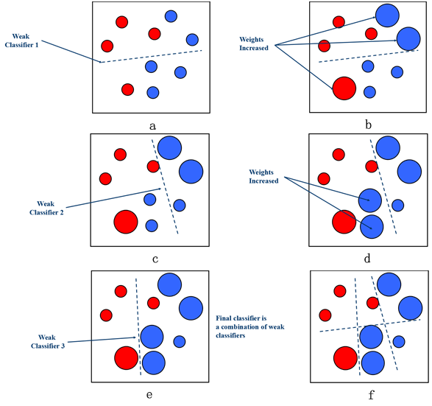
Algorithm
adaboost classifier algorithm

Slide 6

Why we use adaboost classifier
Ensemble Learning
AdaBoost is an ensemble learning method, meaning it combines the results of multiple weak learners to improve overall performance. This often leads to more robust and accurate models compared to individual models.
Effective in Practice
AdaBoost has been shown to be effective in practice across a wide range of applications. It has been successfully used in both binary and multiclass classification problems.

Slide 7


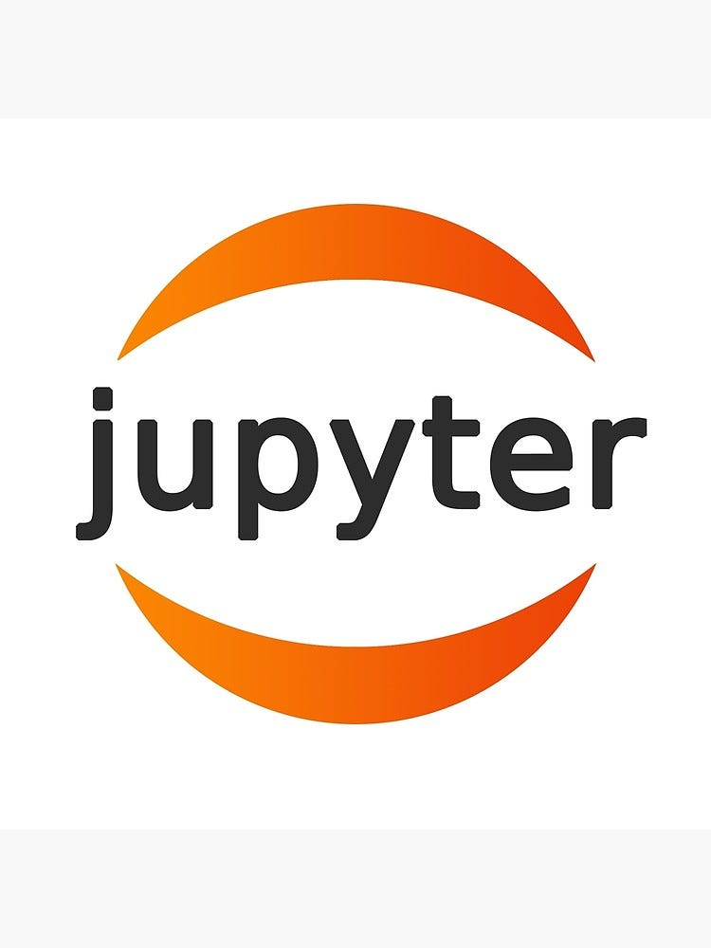

Technology

Slide 8
Features on which we predict disease
Age
Sex
Chest pain type
BP
Max HR
ST depression
Slope of ST

Slide 9
Summary
A Heart Disease Prediction project involves utilizing machine learning to analyze medical data, including factors like age, blood pressure, and cholesterol levels, to predict the likelihood of an individual having heart disease. After cleaning and exploring the data, a suitable machine learning algorithm is chosen and trained on a dataset. The model's performance is evaluated, fine-tuned for optimal results, and then deployed for predictions. Regular monitoring and collaboration with healthcare professionals ensure ongoing accuracy and adherence to ethical and regulatory considerations.

Slide 10

Thank you

